Slide 1
Diabetes Readmission Prediction
Presented by:
Shreenath K S (11810117)
Vishal S Shetty (11810095)

Slide 2


INTRODUCTION
Executive Summary:
Diabetes is a chronic condition prevalent among more than 100 million people across the world. according to a new report released today by the Centres for Disease Control and Prevention. The report finds that as of 2015, 30.3 million Americans – 9.4 percent of the U.S. population –have diabetes. India informally known as the Diabetes capital of the world with 50 million having diabetes.
Problem Statement
Hospital readmission for diabetic patients is a major concern in the United States. Over $250 million dollars was spent on treatment of readmitted diabetic inpatients in 2011 alone. Diabetes is chronic and does not have any specific cure. The chances of readmission of diabetic patients are quite high. Despite major advances in science and technology, diabetes continues to be a chronic disease, with a thirty-day readmission rate of around 20%, as compared to an average of 12% for the rest of the diseases. Additionally, readmissions cost hospitals a fair amount of money, so the end goal is to identify and reduce the possibility of a readmission
Objective
Prevention of patient readmission has been given a greater importance due to large cost involvement. The objective of this project is to predict whether the patient will be readmitted to the hospital or not.
Identify the key factors that influence readmission for diabetes and to predict the probability of patient readmission.
Using Unsupervised & Supervised techniques need to able to arrive at best fit recommendations which would reduce the readmissions and also explore avenues to reduce cost.

Slide 3


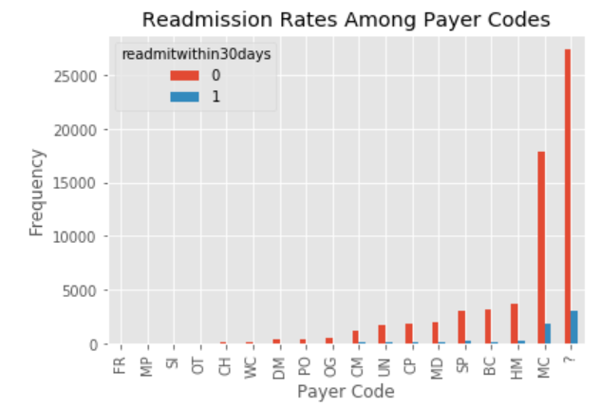
EDA
Modeling
Data wrangling
Feature
Engineering
Findings
Data Cleaning
Data Understanding : Wrangling
Understanding the variable in terms of target and the response. Target [Dependent] variable is whether or not a patient was readmitted to a medical facility within 30 days. All other variables are predictors [Independent] This project aims to determine which of the predictors are most useful in predicting the outcome. We had 3 classes in the target variable i.e. >30 days, <30 days & No. Since our objective is to predict readmission we had combine > 30 & <30 to indicate it as 1 else, 0.
Data Cleaning:
Removing columns with missing values.
Renaming Columns for easy understandability.
Removing less relevant observations.
Removing observation which is bias.
Observation:
weight: 96% missing medical specialty: 48% missing payer code: ~44% missing race: ~3% missing diagnosis 3: ~2% missing

Slide 4
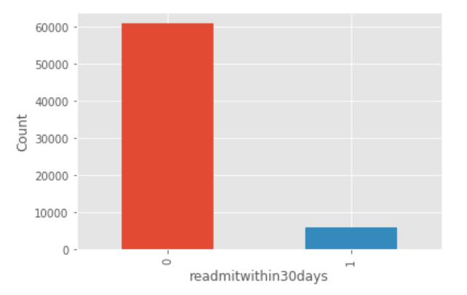
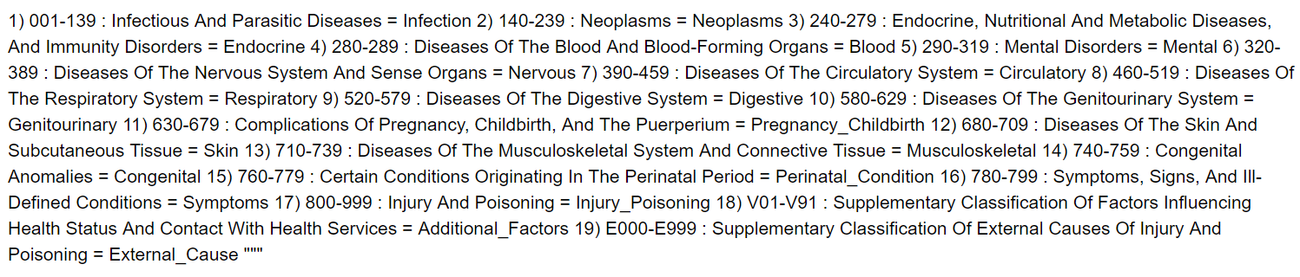
THIS IS A SLIDE TITLE
Feature Engineering
10X
Using ICD-9 Code to interpret the diagnosis (1, 2 & 3) values to textual terminologies, for better interpretation of data.
Renaming columns for better understanding.
One- hot encoding to map the variables.
With this exercise we ensured no null values were present and had sustained only relevant and meaningful information.
Class imbalance

Slide 5

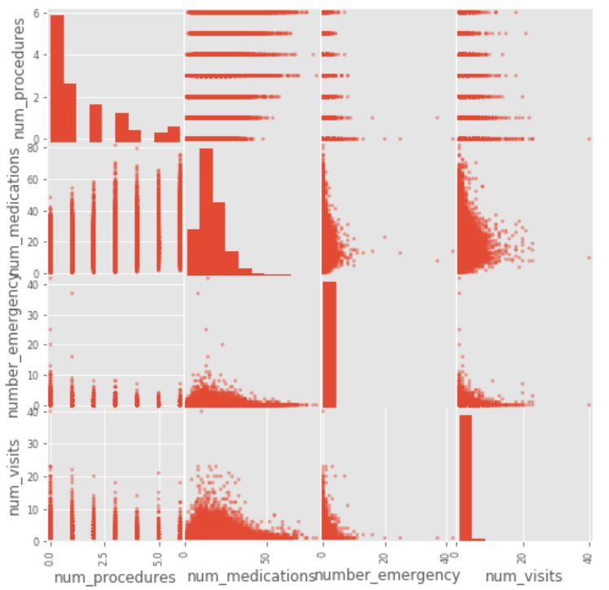
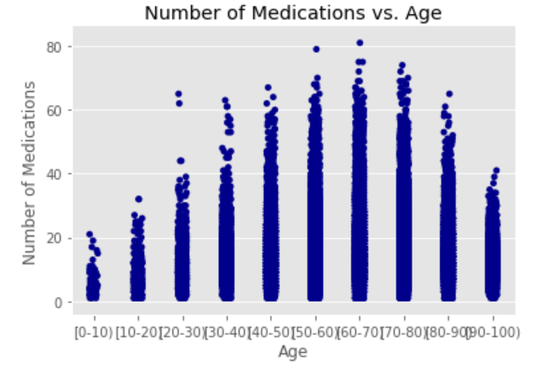
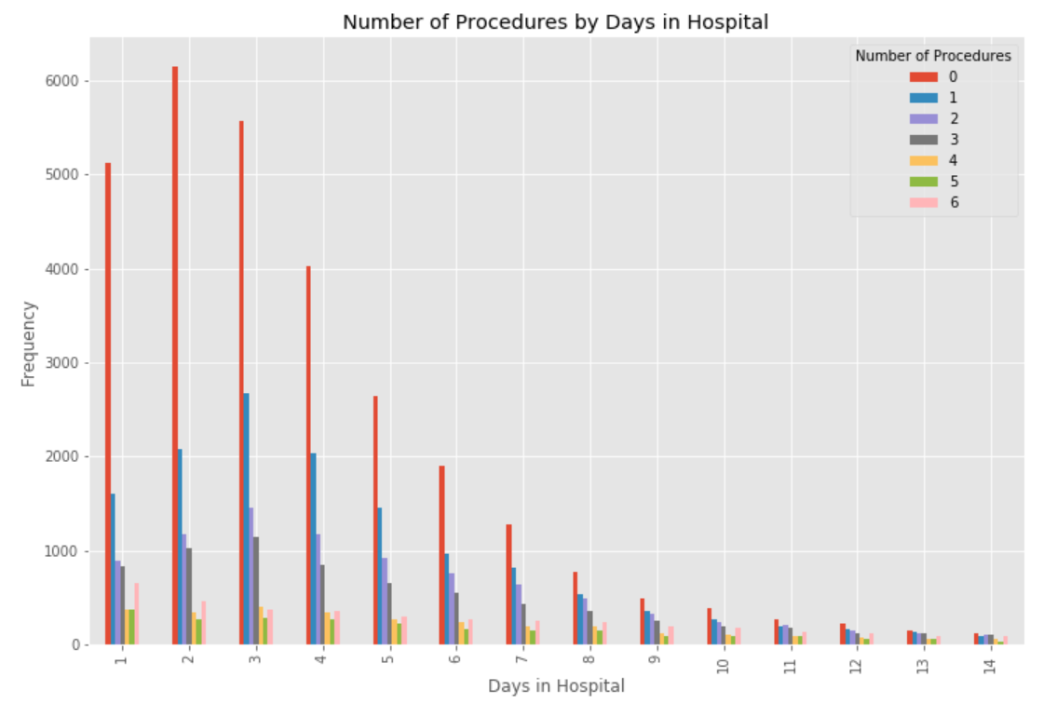
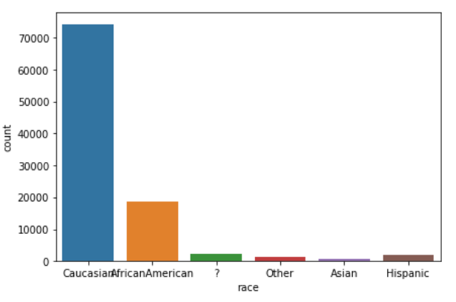
A PICTURE IS WORTH A THOUSAND WORDS
Number of Medication with age.
.
Multicollinearity is likely not an issue for key predictor variables.
Exploratory Data Analysis
Number of procedures by days in Hospital
Race wise diabetes
Notes:
Corr pair plot: In a clear correlation, a sort of cigar-shaped, linear pattern with heavy clustering in the middle would appear on a plot. None of the above plots shows such a pattern, though, so multicollinearity is likely not an issue for any feature pairs here.
Readm by Age: Observations: In general, the number of readmitted patients increases with the number of non-readmitted patients for each age group, so percentages of readmitted patients look similar across age groups. The percentages are not perfectly constant, however: the 80-90 age bracket clearly has a higher percentage of readmitted patients. Thus, there may be some predictive value in higher age brackets.
No. of Medication vs age : The scatter plot indicates that there are more people in higher age groups taking higher numbers of medications, but all age groups show heavy clustering in lower numbers, too. Therefore, it's unlikely that age and number of medications are so highly correlated that one variable would need removal.
Race: We can see that Caucasians are the most affected race among them readmitted

Slide 6
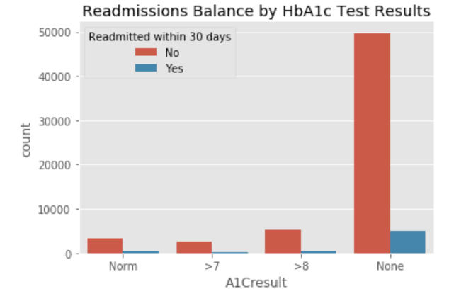
Hypothesis
Does HBA1c result predict readmission with in 30 days?
Ho: Test for HbA1c and readmission within 30 days are independent
H1: Test for HbA1c with readmission are dependent.
Chi- Square test for independence, we get p-value less that Alpha 0.05
This means that there is less than a 5% chance that this relationship is due to random chance. So even though the difference in percentages of readmitted patients for those tested and those not is fairly small, it is evidently not due to chance. HbA1c testing -- perhaps as a binary and as a multi-category outcome -- will be a key variable in final analyses.
HbAlc Test? | Readmission Within 30 Days No Yes All
No | 49718 | 5033 | 54751
Yes | 11052 | 1041 | 12093
All | 60770 | 6074 | 66844
Patients with HbA1c levels tested were less likely to be readmitted within 30 days than were untested patients, and the relationship is not due to chance.

Slide 7

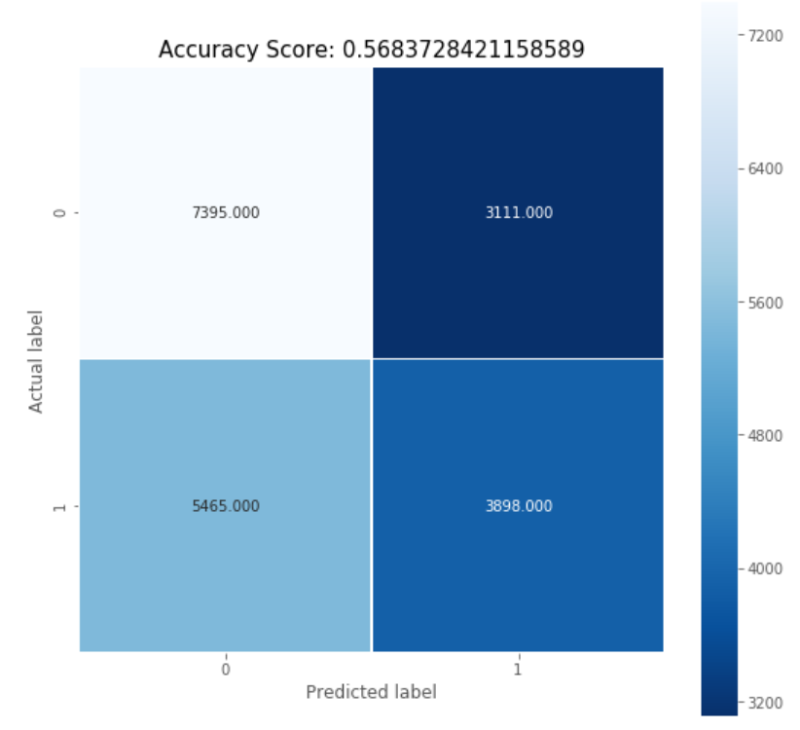

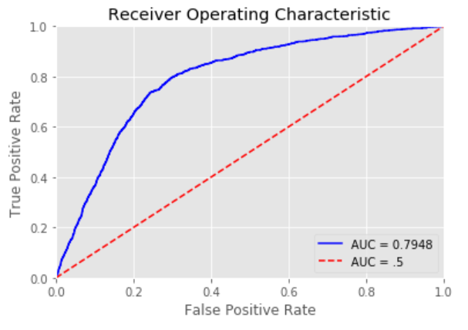

YOU CAN ALSO SPLIT YOUR CONTENT
Logistic Regression
Variable | Coefficient
num_visits | 0.59
number_inpatient | 0.28
discharge_disposition_id_3 | 0.18
discharge_disposition_id_22 | 0.14
first_diag_injury | 0.083
We have split the data 80 – 20 for training & testing respectively.
Regularization with L2 penalty parameter to control overfitting
Prepared 2 models 1 with readmission <30 & >30. Another with only with 30.
Modeling
Accuracy score
Using Readmission as <30 & >30 as 1 we got a score of 56%e
^{57%}
82%
Accuracy score
For within 30 days model
We got 80% for train data and 82% for test data which shows our model was good fit.

Slide 8

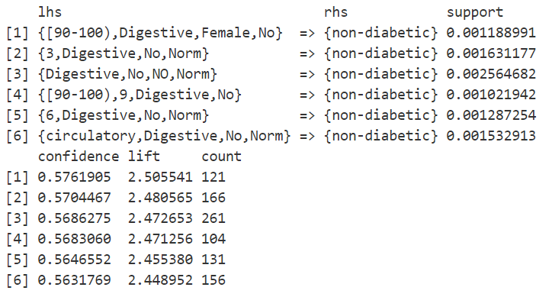
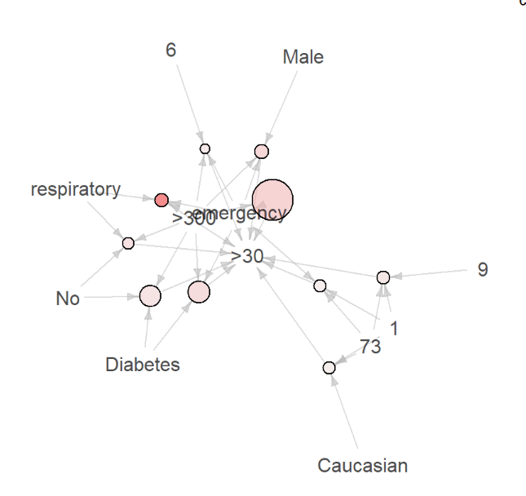
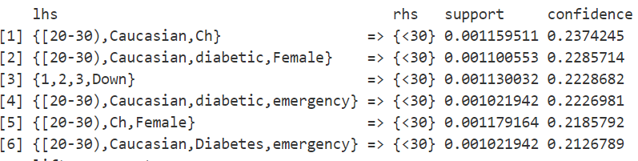
USE DIAGRAMS TO EXPLAIN IDEAS
Pattern mining
Problem Statement:
Predicting the likelihood of a non-diabetic patient being readmitted. Find the pattern b/w non-diabetic patients and readmissions
We can see around 72 rules for Readmission of Non Diabetic, with 50% confidence by lift.

Slide 9
Recommendations & Insights
When a patient is discharged to a hospice facility or a SNF (Skilled Nursing facility)
When a patient has too many inpatient visits or emergencies in the past year, or large number of procedures
When the age of patient is above 70
When secondary diagnosis is either Neoplasms or endocrine, nutritional and metabolic diseases, and immunity disorders
When primary diagnosis is diseases of the skin and subcutaneous tissue.
When patient is admitted from Emergency Room.
The result of ours analysis can help the stakeholder of this project to determine whether monitoring HBA1c level should be a significant part of treatment
Using a machine learning platform, healthcare organizations can develop a good patient monitoring plan to anticipate the potential time of readmission and to detect any conditions or symptoms that may cause the readmission. It allows hospitals to find the reasons behind high readmission rates and address them by coordinating with care providers and physicians to optimize hospital stays.

Slide 10
THANKS!
Future works
Using Neural Network
Other supervised learning techniques like Random Forest, Decision tree & Bayesian Network.
Text mining using medical records.
Limitation:
Data set is limited, hence cannot generalize this model to a larger population.

